Slide 1
J2ME and Using Multimedia
Feb 27, 2007

Slide 2
Introduction
MIDP 2.0 APIs together with the optional package Mobile Media API 1.1 (MMAPI), offers a range of multimedia capabilities for mobile devices such as audio and video playback and recording.
MIDP 2.0 comes with a scaled down version of MMAPI that only supports audio (including tones) and excludes anything to do with video or images. This comes handy for phones with limited multimedia capability.

Slide 3
MIDP 2.0 and MMAPI
MMAPI contain multimedia methods that superset those present in MIDP 2.0.
MIDP 2.0 contains the Audio Building Block (ABB) that is also part of the Mobile Media API (MMAPI). ABB allows the adding of audio such as tones, tone sequences and WAV files to MIDP applications without relying on MMAPI. On devices that also include a MMAPI implementation, more funconality can be realized such as video streaming.

Slide 4
MMAPI Background
MMAPI, also known as JSR 135 in the Java Community Process (JCP), extends the functionality of the J2ME platform by providing audio, video, and other time-based multimedia support to resource-constrained devices.
It is simple and lightweight and provides access to native multimedia services available on a given device.
The current version (1.1) includes security updates, and is distributed as an optional jar file in the J2ME wireless toolkit 2.2.
For for more info: http://java.sun.com/products/mmapi/overview.html
http://jcp.org/en/home/index
Notes:
JSR stands for Java Specification Request.
JCP is the international Java developer community whose charter it is to develop and evolve Java technology specifications, reference implementations, and technology compatibility kits.
Java Specification Request (JSR): The document submitted to JCP working group proposing the development of a new Specification or significant revision to an existing Specification.

Slide 5
MMAPI Organization
MMAPI is built on a high-level abstraction of all the multimedia operations possible on a resource-limited mobile device.
These operations are abstracted into three classes: Player and Control interfaces, and the Manager class. Another class, the DataSource abstract class, is used to define a new way of reading data by locating resources.
The Manager class is used to create Player instances for different media by specifying DataSource instances. The Player instances are then manipulated by using Control instances (such as a volume control).

Slide 6
Manager
instantiates
DataSource
Player
provides resources to
is controlled by
Control

Slide 7
Static Methods
Manager can instantiate players:
  createPlayer(DataSource source)
  createPlayer(InputStream stream, String type)
  createPlayer(String locator)
  createPlayer("capture://audio“)
  createPlayer"capture://video“)
  createPlayer("capture://radio?f=101.1&st=stereo“)
  createPlayer("rtp://host:port/type“)
  createPlayer("device://tone“)
  createPlayer("device://midi“)

Slide 8
Supported Protocols and Content Types
getSupportedProtocols(String contentType)
returns a String array of supported protocols.
getSupportedContentTypes(String protocol)
returns a String array of supported content types for a
given protocol
Passing null to the above methods will return all supported
protocols and content types respectively.

Slide 9
States of the Player
Upon creation, the player is in an UNREALIZED state and must be REALIZED and PREFETCHED before it can be STARTED.
Realization is the process where the player examines the source or destination media resources
Prefetching happens after realization and the player actually acquires these resources.
Player is started using the start() method.
Going from STARTED to PREFETCHED state pauses the player, and calling start() again restarts from the paused.
Note: It is recommended to first invoke realize() and prefetch() methods before invoking start() method to avoid any latency when you want the player to start.
If you don’t explicitly invoke relize() and prefetch(), the start() method implicitly calls them.
You can set the player instance to CLOSED by invoking close() method on it.
The otheroption is to deallocate the player by calling deallocate(), which returns the player to the REALIZED state and releasing all its associated resources.

Slide 10
realize()
UNREALIZED
REALIZED
deallocate()
STARTED
prefetch()
deallocate()
stop()
close()
start()
CLOSED
PREFETCHED

Slide 11
Listeners for Player States
Notification of the transitions between different states can be delivered to attached listeners on a player.
To add a listener to the Player instance you invoke
addPlayerListener(PlayerListener listener)
Transitions states are notified to the listener by the method
playerUpdate(Player player, String event,
Object eventData)

Slide 12
Player Controls
The Player interface extends the Controllable interface.
A player thus enables control over the properties of the media that it is playing.
VolumeControl controls the volume of several kinds of media.
Specific media controllers are VideoControl, MIDIControl.
getControls() returns an array of Control instances.
getControl(String controlType) returns an individual Control.

Slide 13
Audio Playback
Create a Player instance using a String locator. The Player will then be realized, prefetched, played and finally closed.

Slide 14
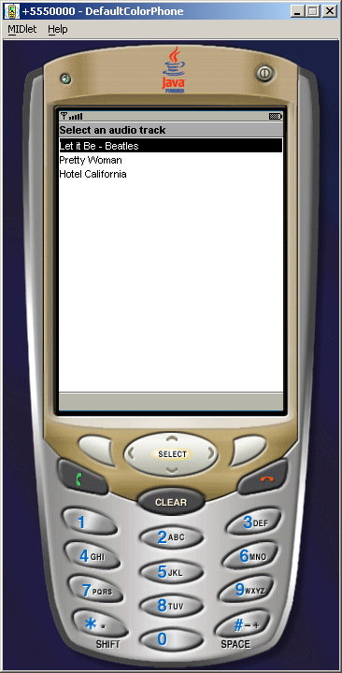
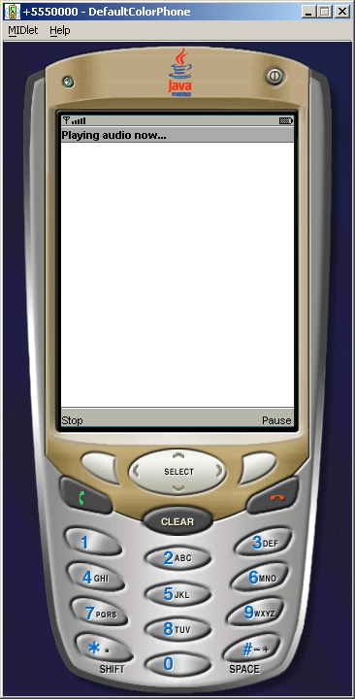

Slide 15
Audio Playback
Run the ‘Audiodemo’ example that is in your apps folder of the WTK.
Modify the previous application to do audio capture rather than just playback from an existing file.

Slide 16
In-class Exercise
Modify the audio demo to play video.

Slide 17
import javax.microedition.media.*;
import javax.microedition.media.control.*;
…
VideoControl vc = null;
if((vc = (VideoControl)player.getControl("VideoControl")) != null)
{
Item videoDisp = (Item)vc.initDisplayMode(vc.USE_GUI_PRIMITIVE, null);
form.append(videoDisp);
}
Also check the available video formats on your phone..

Slide 18
Next Class
J2ME/PyS60 Programming Mashups
  Class will be divided into groups.
  Each group will work on a programming assignment and show at end of class.

